Slide 1


AGE 316:
MICROCOMPUTER SYSTEMS
LECTURE 7: SERIAL COMMUNICATION & DEBUGGING
Dr. Kadeghe Fue
Department of Agricultural Engineering

Slide 2



Recap: Lecture 6
Analog Read: Using the ADC (0-1023) to read voltage sensors.
PWM: Faking analog output (0-255) using analogWrite().
Map Function: Converting one range to another.

Slide 3





Why do we need to talk?
A microcontroller working in silence is hard to verify. We need it to communicate for two main reasons:
Debugging
Interfacing
The Arduino tells us what it is "thinking" or the values of its variables.
Sending data to other devices (GPS, WiFi modules, Laptops).

Slide 4

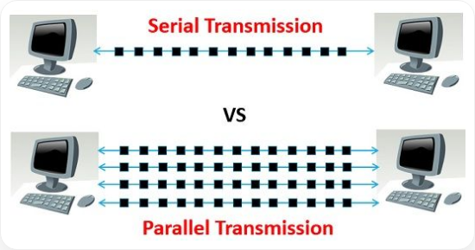
Parallel vs. Serial
Parallel
Sends multiple bits at once (like an 8-lane highway).
Fast, but requires many wires.
Serial
Sends one bit at a time (like a single-lane road).
Slower, but cheap and reliable (only 2 wires).

Slide 5

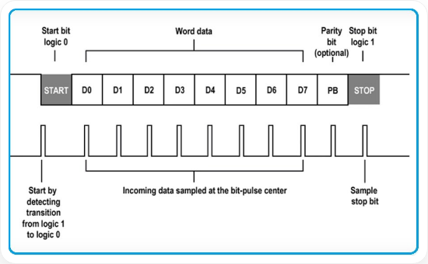
How Serial Works (UART)
Universal Asynchronous Receiver-Transmitter
The Arduino uses a protocol called UART.
•
0V (LOW): Represents a '0'
•
5V (HIGH): Represents a '1'
•
Asynchronous: No clock wire. Timing must be agreed upon beforehand.
Data Frame: Start Bit -> Data Bits -> Stop Bit

Slide 6

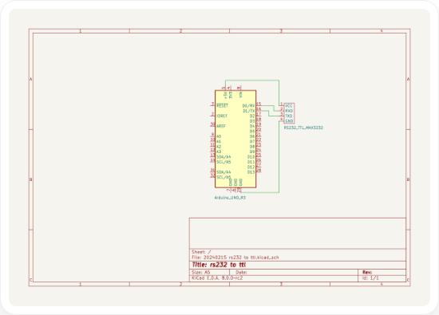

Wiring: TX and RX
Communication requires two specific lines:
TX (Transmit) → Sends Data
RX (Receive) ← Gets Data
The Golden Rule of Wiring:
TX
RX

Slide 7

Baud Rate: The Speed of Talk
Since there is no clock wire, both devices must agree on the speed of transmission.
9600
Bits per second (bps)
Common rates: 9600, 115200. Mismatched rates = Gibberish output.

Slide 8

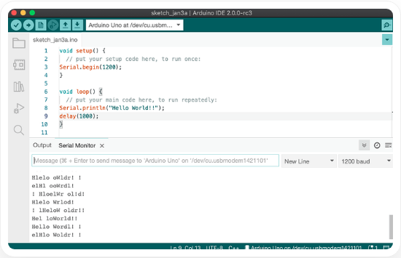
The Serial Monitor
The Arduino IDE has a built-in tool to see what the Arduino is sending.
•
Click the Magnifying Glass icon (top right).
•
Or press Ctrl + Shift + M.
Baud Rate

Slide 9


Step 1: Initialization
You must start the Serial port in the setup() function.
void
setup
// Open serial port at 9600 bps
Serial.begin
This configures the digital pins 0 (RX) and 1 (TX) for communication.

Slide 10





Step 2: Speaking (Printing)
Use these functions in your loop() to send data to the PC.
Serial.println()
Serial.print()
Prints text and adds a NEW LINE.
Prints text on the SAME line.
Serial.println
"Hello"
Serial.print
"Hello "
Serial.println
"World"
Serial.print
"World"
Output:
Hello
World
Output: Hello World

Slide 11

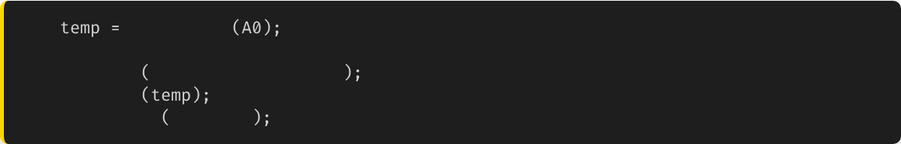

Formatting Output
Combining text and variable data creates readable logs.
int
analogRead
Serial.print
"Temperature Raw: "
// Label
Serial.print
// The Variable
Serial.println
" units"
// Unit + New Line
Temperature Raw: 512 units
Temperature Raw: 513 units
Temperature Raw: 510 units

Slide 12



The Art of Debugging
Bug: An error in software or hardware.
Debugging: The process of finding and fixing it.
Since we can't see electricity, we use Serial.print to make the invisible visible.

Slide 13

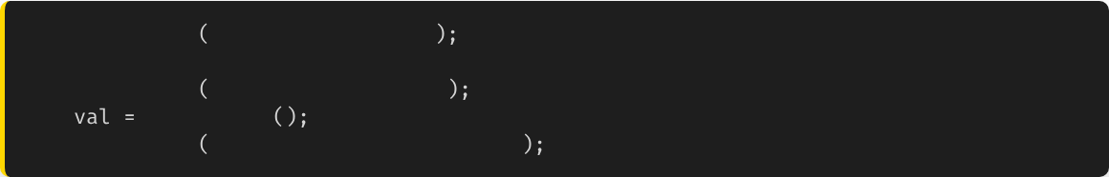
Debugging Strategy: Checkpoints
If your code isn't working, place "Checkpoints" to see where it stops.
Serial.println
"1. Starting Loop"
// ... complex code ...
Serial.println
"2. Reading Sensor"
int
readSensor
Serial.println
"3. Sensor Read Complete"
If you see "2. Reading Sensor" but never see "3...", you know exactly where the crash is!

Slide 14
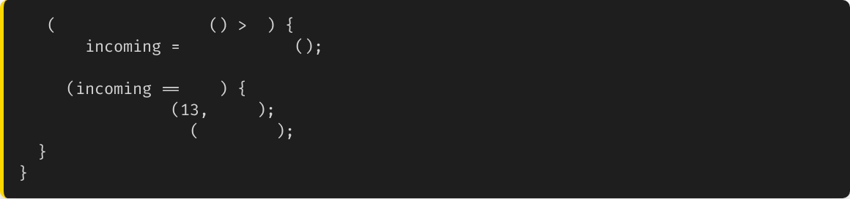
Receiving Data (Listening)
The Arduino can also listen to your keyboard.
if
Serial.available
0
char
Serial.read
if
'1'
digitalWrite
HIGH
Serial.println
"LED ON"

Slide 15

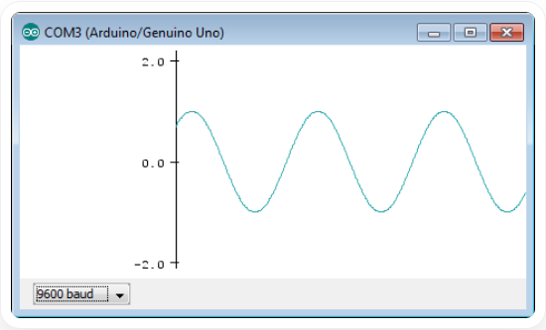

The Serial Plotter
A built-in tool to Graph your data in real-time.
Perfect for visualizing sensors (temperature changes, heartbeats, light levels).
How to use:

Slide 16

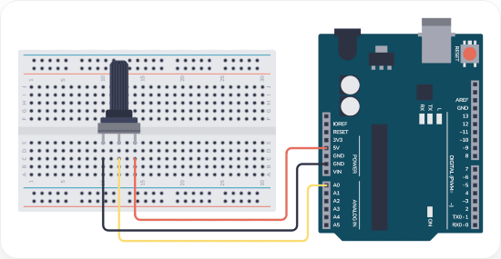
Practical: Sensor to Plotter
Objective:
Visualize the rotation of a Potentiometer.
1.
Connect Potentiometer to A0.
2.
Write code to analogRead(A0).
3.
Serial.println() the value.
4.
Open Tools > Serial Plotter.

Slide 17






Summary
UART
Serial Monitor
Plotter
Asynchronous Serial communication. Uses TX and RX lines.
Crucial tool for printing data and debugging logic.
Visualizes numerical data as a real-time graph.

Slide 18


Questions?
"The only stupid question is the one you don't ask."
Dr. Kadeghe Fue
Sokoine University of Agriculture

Slide 19







Image Sources
https://techdifferences.com/wp-content/uploads/2016/04/Untitled.jpg
Source: techdifferences.com
https://microcontrollerslab.com/wp-content/uploads/2019/02/UART-communication-frame.jpg
Source: microcontrollerslab.com
https://europe1.discourse-cdn.com/arduino/original/4X/9/f/0/9f077ecc2426c1e63be5984b159bcbbdcc50d833.png
Source: forum.arduino.cc
https://europe1.discourse-cdn.com/arduino/optimized/4X/4/0/d/40d546c24fb876f7ff4b8d24ef5aee9d34aa54cb_2_690x433.png
Source: forum.arduino.cc
https://www.idogendel.com/en/wp-content/uploads/2015/11/SerialPlotterSine.png
Source: www.idogendel.com
https://www.build-electronic-circuits.com/wp-content/uploads/2023/08/2D_Circuit-Arduino-Potentiometer-dibujo-1024x509.png
Source: www.build-electronic-circuits.com

